Slide 1

Public transport and optimization

Slide 2

Project definition and design thinking
......

Slide 3
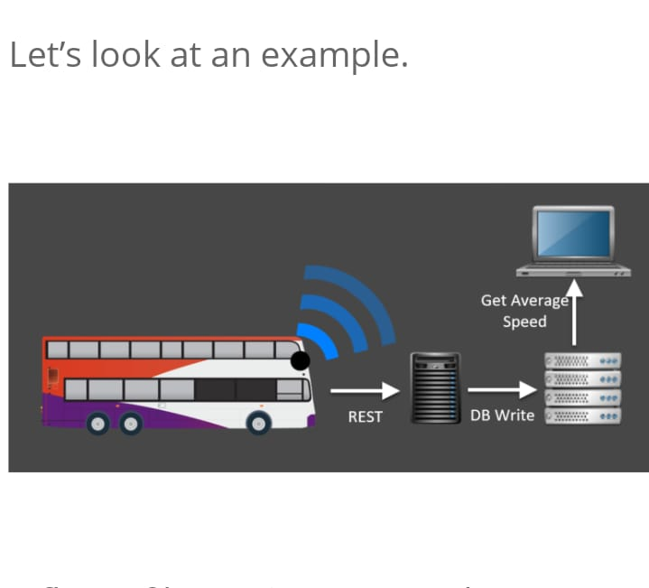
.....

Slide 4
PROJECT DEFINITION
It includes an introduction to mathematical modeling, continuous and discrete optimization, numerical optimization, computational complexity analysis, metaheuristics, and multi-objective optimization.
The process of analyzing shipments, rates and. Constraints to produce realistic load plans that reduce overall freight spend and gain efficiencies across entire transportation networks.
A system of transport for passengers by group travel systems available for use by the general public unlike private transport, typically managed on a schedule, operated on established routes

Slide 5
TYPES OF PUBLIC TRANSPORT AND OPTIMIZATION
city buses
Trolleybuses
trams (or light rail)
passenger trains
rapid transit (metro/subway/underground, etc.)
ferries

Slide 6
DESIGN THINKING
Design thinking has revolutionised the way we approach problem-solving and innovation.
It is a problem-solving methodology that prioritises empathy, experimentation, and iteration to create human-centered solutions. In the world of app development, design thinking is an invaluable tool for creating features that meet the needs of users in a way that is both efficient and effective.
The first stage of any design thinking process involves designers seeking to understand and empathise with the needs of the users by conducting research, interviewing users and gathering data to gain insights into the users’ needs, challenges and behaviours.

Slide 7
.......
The second step in the design thinking process is the define stage. In this stage, designers define the problem they want to solve based on the insights they have gained from research. The problem statement that is created is a clear description of the user’s needs that should be addressed.
The ideate stage involves brainstorming as many ideas as possible to solve this particular problem. Below are some of my ideas
The penultimate stage of the design thinking process is where designers create low-fidelity prototypes to test and refine ideas, using these to gather feedback from users and stakeholders

Slide 8

......

